Slide 1


Chapter 1
Introduction

Slide 2
World of mobile computing
Web browsers for desktop/laptop/netbook computing
Internet Explorer, Firefox, Chrome, Safari, and Opera running on Windows, Mac, etc.
Tablets, smartphones, smart TVs, and other mobile devices
Run on Android by Google, iOS by Apple, Windows RT, and several other competing platforms including Blackberry and Firefox.
These dedicated applications are specific to a platform in the native application development environment.

Slide 3
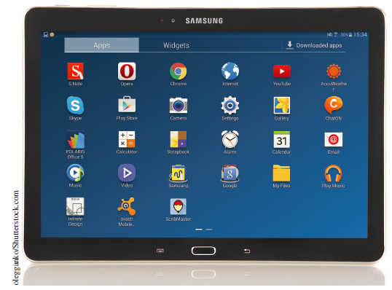
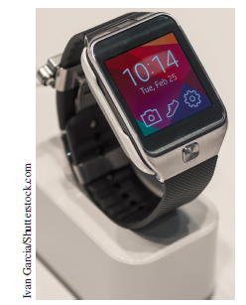
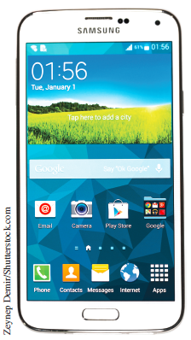
Devices that run on Google’s Android operating system
Devices that run on Google’s Android operating system include phones, tablets, and wearable watches that can be programmed using Java.

Slide 4
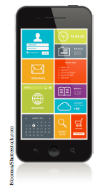
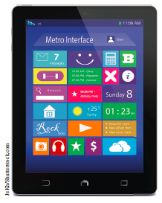
Devices that use Microsoft’s Windows
Microsoft’s Windows phones and tablets are best programmed using their .Net framework and languages such as C# or Visual Basic.
While a significant percentage of the apps still need to be developed in the native development environment, the emergence of HTML5 and JavaScript make it possible to develop apps that can be run across all mobile platforms through the web.

Slide 5
Developing, installing, and testing first app
Chapter 2.
Information such as how to manage the file access control on a UNIX/Linux server and incorporating videos (a feature that is new to HTML5).
How to create a simple HTML5-based app.
How to put the app on the web for general access through the Internet.
How to enhance the presentation with CSS3
How to add multimedia to the web page, including images and videos

Slide 6
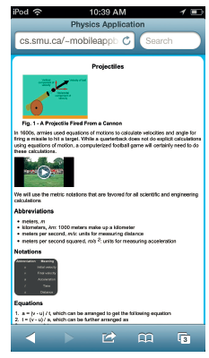
Example of a web page
A web page with an image, a video, and a table with presentation that is enhanced using CSS3, which is accessed from a UNIX server.

Slide 7
Making apps more interactive through data input
How to change the layout of the output depending on the types and sizes of screens.
How to switch between textual and graphical output.
How we can add more interaction/input so that a user can get more refined output if he or she desires.

Slide 8
More in Chapter 3
JavaScript
jQuery for mobile devices
How to embed JavaScript in a web page
How to use an external JavaScript file on a web page
How to use CSS3 elements designed for mobile devices
How to accept input through a web page
How to use different types of input widgets
How to link multiple mobile pages in an app

Slide 9
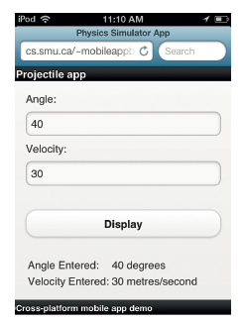
More in Chapter 3 (cont’d)
A physics Projectile app that accepts textual input through an HTML5 app.

Slide 10
Making apps do significant computing
Apps will deal with a collection, sequence, or array of data.
The collection of items adds a new dimension to computing that will be explored in Chapter 4.
In the process we will be learning a number of interesting aspects of computing including
• How to validate input
• How to do computations based on input
• How to do conditional computing
• How to do iterative computing
• How to use arrays in JavaScript

Slide 11
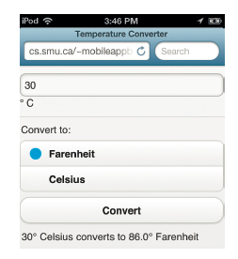
Temperature converter app

Slide 12
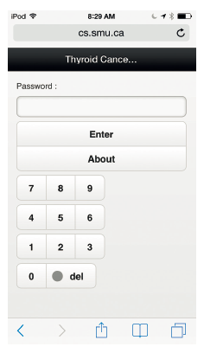
A menu-driven app to monitor important indicators
Use of a real-world example that monitors blood test results of thyroid cancer patients.
First, we create a numeric pad to enter a password for security purposes.

Slide 13
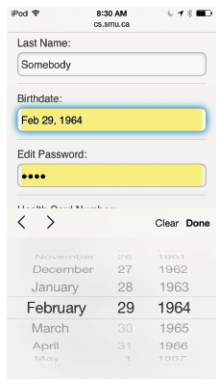
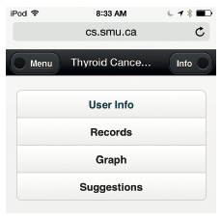
A menu-driven app to monitor important indicators (cont’d)
The patients will be asked to input their basic information
Show a menu-driven system that is geared towards mobile devices.

Slide 14
Data storage and retrieval
Set up the structure of the app to monitor blood tests of thyroid cancer patients.
Study all the intricate programming details involved in managing a data management system.
Securely store the information on our device, so that it is available even when we have no Internet connection.
Discuss JSON (JavaScript Object Notation), which is syntax for storing and exchanging text information.

Slide 15
More in Chapter 6
What is local storage?
How can we store and retrieve data locally on the device?
How can we check a password?
How can we make sure that the user has accepted the disclaimer?
How can we accept and manage user profiles?
How can we store and manage an array of records?

Slide 16
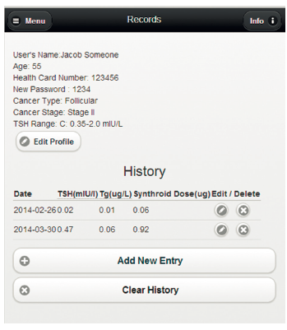
More in Chapter 6 (cont’d)
The tabular history of records along with the personal information that is retrieved from the local storage of the device.

Slide 17
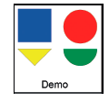
Graphics on HTML5 canvas
The basics of canvas drawings.
A new addition in HTML5.
It allows us to create drawings on a web page.

Slide 18
The summary of skills presented in Chapter 7
How to work with canvas
How to draw various shapes
How to display some of the graphical gadgets
How to draw graphs
How to create an icon for the app on the home screen
How to run an app locally with no Internet connection

Slide 19
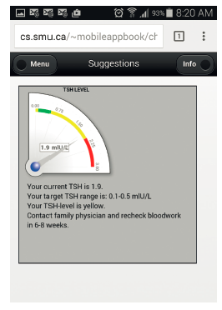
Displaying the advice with the help of a gauge meter
The gauge meter that is created as part of the advice screen of the Thyroid app.

Slide 20
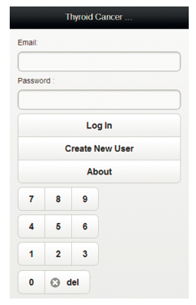
Using servers for sharing and storing information
See how we can run these apps even when the device is not connected to the Internet.
Sync information from our Thyroid app on a server.
Use the server for emailing tables and charts.
The modified login screen for the server-based Thyroid app.

Slide 21
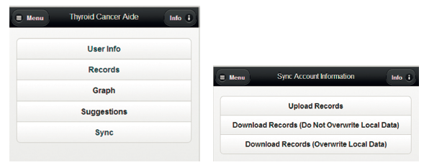
Modified menu screen for the server-based Thyroid app with sync option
When a user presses the sync button, the user will have an option to upload the records or download the records.
The user can choose whether or not to overwrite the records with the same date on the device.

Slide 22
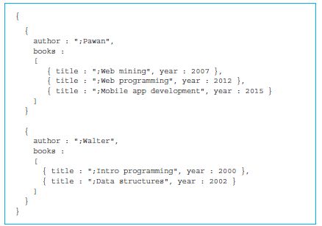
Using MongoDB server for sharing and storing information
The data management part of the server-based Thyroid app.
It will be based on a JSON-based non-relational database model.
An introduction to MongoDB with simple illustrative examples.

Slide 23
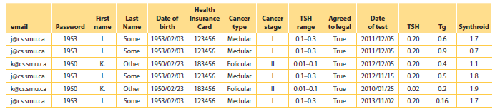
Using a relational database server for sharing information
Relational databases will continue to play a major role in the management of data.
They provide a more structured view of the database.

Slide 24
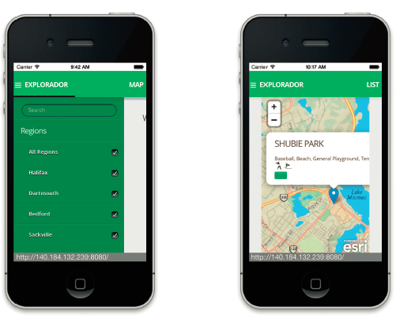
Using web templates
Popular for using different data sources to present a large amount of information on similar-looking web pages.
Chapter 11 uses one of the popular web template systems called handlebars to build an app called Explorador that helps us explore parks in a metro region.

Slide 25
Working with image databases, maps, and location tracking
Show how to obtain the location information and utilize it to enhance the user experience with the help of maps.
Extend our understanding of databases for storing multimedia information.

Slide 26
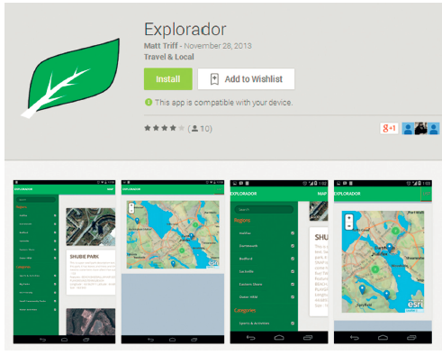
Cross-platform and native app development and testing
Discuss and showcase the hardware and software development tools necessary for native app development.
Demonstrate how some of the apps developed in the previous chapter can be converted to the native platforms including iOS and Android.

